Slide 1
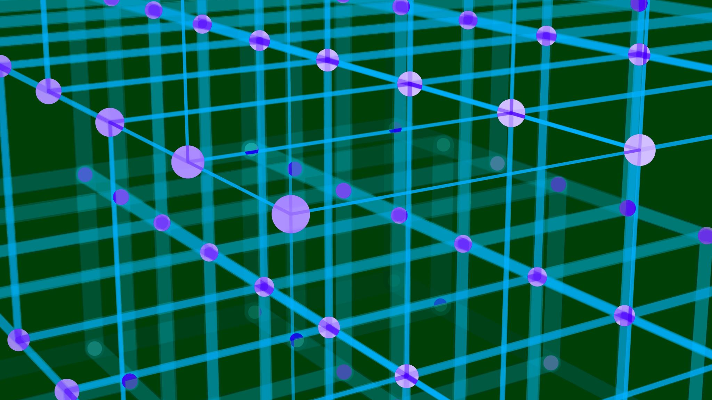
Quantities and units
Attempted ontology alignment - DRAFT
A. Magnien, UIC December 2024

Slide 2
Problem statement
Representation of quantities and units (Q&U) knows multiple standards:
Most seem valid and up-to-date
None stands out (lacking “popularity measure” or adoption trends)
These standards mostly ignore each other
These standards are often used by other standards relevant to our use cases
e.g. ISO 19103 uses UOM “units of measure” ontology
Choosing a single Q&U standard would imply re-engineering others - risky
Proposed solution
Do not unbundle existing standards (packing Q&U) when using them, hence:
Prepare a minimal “alignment package” to demonstrate equivalence and facilitate the switch between Q&U standards at runtime
Possibly, propose a “preferred Q&U standard” for the CDM if there is a clear benefit, from a CDM-internal point of view, or given the overall standardisation situation

Slide 3
“Standards” under scrutiny
“Standards” should be understood in the wide sense: industry(de facto) standards, official standards, standard tools, …
The standards listed below may include quantities (Q), units (U), and concepts requiring these (C).
ISO TC 211 ontologies (Q; uses UOM for units)
SOSA/SSN
QUDT (Q, U)
UCUM
UOM (U)

Slide 4
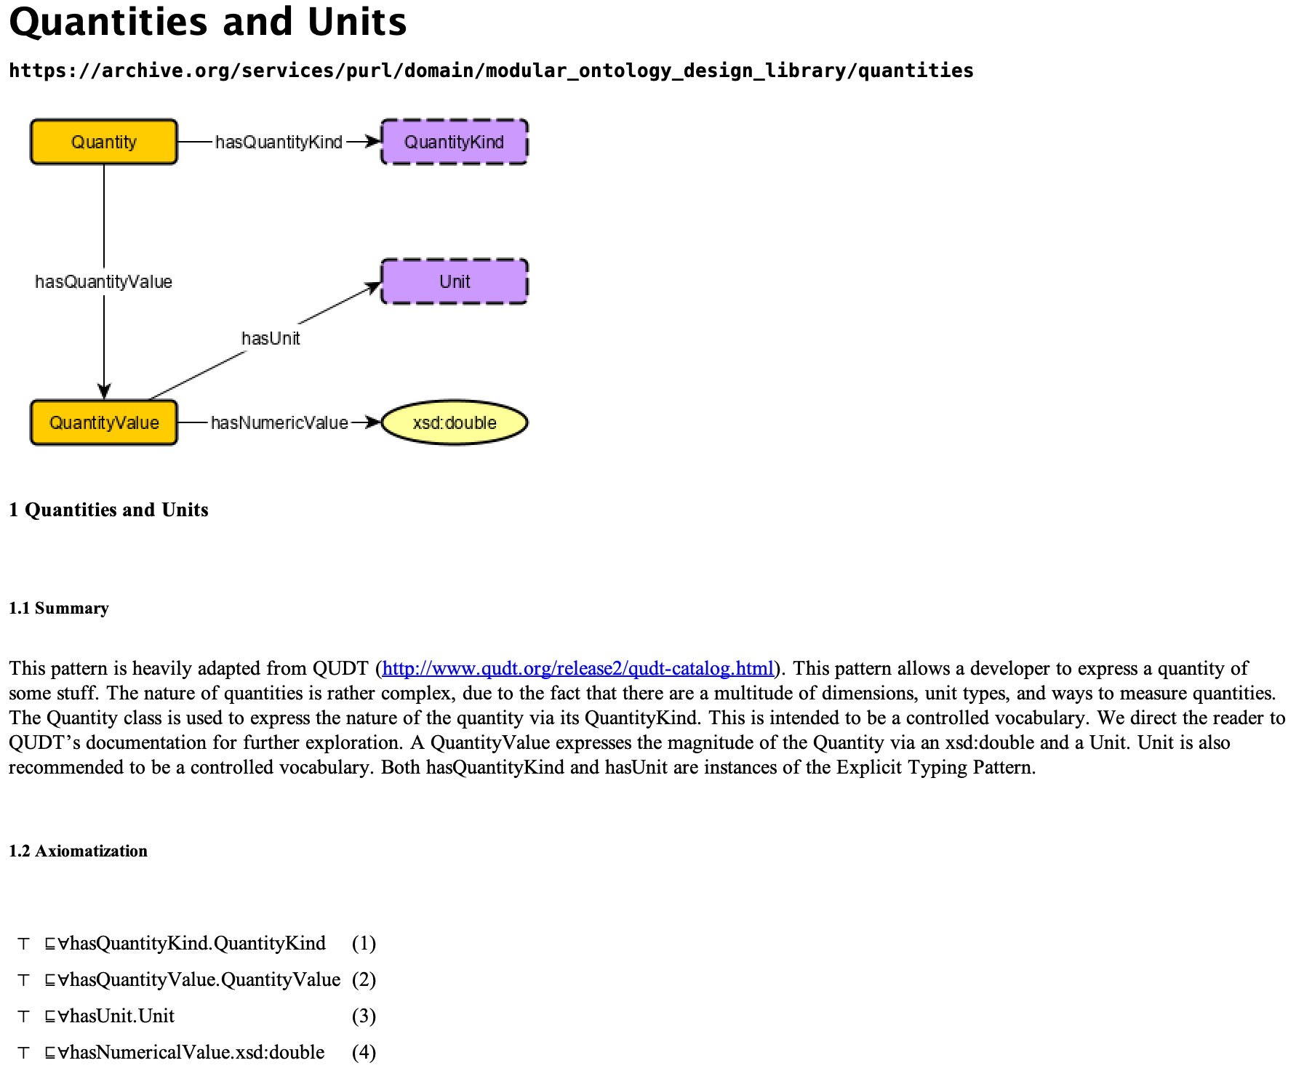
CoModIDE
CoModIDE is (trivializing a bit, sorry for that) a “cookbook” of common modelling patterns in RDF/OWL.
It is based on observed “good practice” and published as a Protégé Desktop plug-in.
The picture is copied from the plugin built-in documentation.
The rationale behind CoModIDE is published in:
Modular Ontology Modeling: A Tutorial, Cogan Shimizu, Pascal Hitzler, Adila Krisnadhi, Semantic Web 14:459-489, 2022
Source: CoModIDE plugin

Slide 5
Shortcomings
A cookbook should cover 80% of needs, not 100%
Here, the restrictions are
All values are numeric
The numeric type is xsd:double
SOSA/SSN ontology (semantic sensor network) is more general

Slide 6
SOSA/SSN
Version examined: latest draft, Dec. 13, 2024
Two properties for result:
hasSimpleResult is a data(type) property, value is of type rdfs:Literal
It may include units information, e.g.
"23.5"^^unit:DEG_C (using the UCUM code)
hasResult is an object property

Slide 7
QUDT
Of particular interest is the ability of QUDT to handle ratios, esp. “dimensionless” ones:
E.g. a slope can be expressed in mm/m or permille, and converted to (or from) cm/m or percent
Note: UCUM does this for certain units, e.g radian (^^ucum:rad)

Slide 8
Implementation – object property case
using QUDT
using UCUM
@prefix qudt: <http://qudt.org/schema/qudt/> .
@prefix unit: <http://qudt.org/vocab/unit/> .
@prefix xsd: <http://www.w3.org/2001/XMLSchema#> .
<#LengthOfBody>
a qudt:Quantity ;
qudt:numericValue "230"^^xsd:double ;
qudt:unit unit:Meter ;
qudt:quantityKind qudt:Length .
@prefix ucum: <http://unitsofmeasure.org/ucum#> .
@prefix xsd: <http://www.w3.org/2001/XMLSchema#> .
<#LengthOfBody>
a ucum:Quantity ;
ucum:numericValue "230"^^xsd:double ;
ucum:unit "m" .
<#LengthOfBody>
a ucum:Quantity ;
ucum:value "230 m"^^ucum:UCUMLiteral .
<#LengthOfBody>
a qudt:Quantity ;
qudt:hasValue "230 unit:Meter"^^qudt:QuantityValue .
<#LengthOfBody>
a <http://example.org/Length> ;
<http://example.org/hasLength> "230"^^ucum:meter .
<#LengthOfBody>
a <http://example.org/Length> ;
<http://example.org/hasLength> "230"^^qudt:Meter .

Slide 9
Implementation – data property case
@prefix ex: <http://example.org/> .
@prefix ucum: <http://unitsofmeasure.org/ucum#> .
<#PhysicalBody>
a ex:PhysicalObject ;
ex:hasLength "230"^^ucum:meter ;
rdfs:comment "A physical body with a length of 230 meters"@en .
Support for reasoning is limited, but SPARQL queries can access the chosen unit:
SELECT ?length
WHERE {
<#PhysicalBody> ex:hasLength ?length .
FILTER(datatype(?length) = ucum:meter)
}

Slide 10
About RDF typed literals
… @prefix ucum: <http://unitsofmeasure.org/ucum#> …
ex:hasLength "230"^^ucum:meter
(RDF/XMLsyntax) is equivalent to:
… xmlns:ucum="http://unitsofmeasure.org/ucum#" …
<ex:hasLength rdf:datatype="http://unitsofmeasure.org/ucum#meter">230</ex:hasLength>
(RDF Turtle syntax)

Slide 11
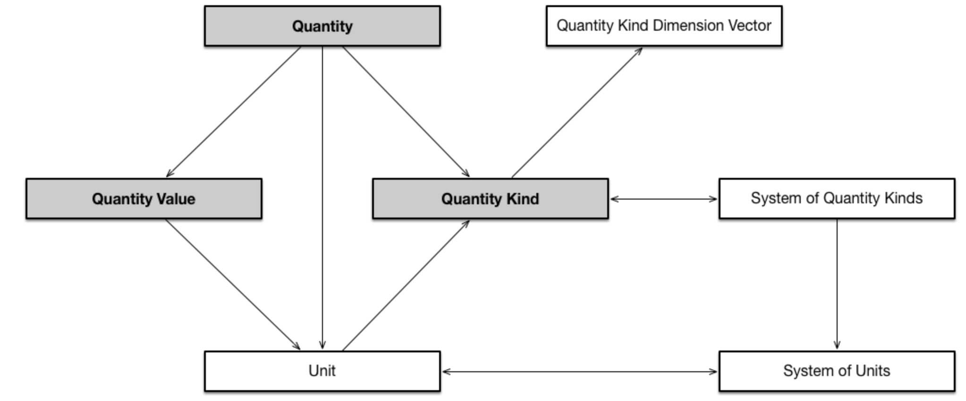
QUDT
Explicitly refers to UCUM for unit representation.
Example: @prefix qudt: <http://qudt.org/schema/qudt/> .
@prefix unit: <http://qudt.org/vocab/unit/> .
unit:Meter
a qudt:Unit ;
qudt:ucumCode "m" ;
qudt:quantityKind qudt:Length ;
qudt:conversionMultiplier "1.0"^^xsd:double .

Slide 12
UCUM
Official website: https://ucum.org/
GitHub https://github.com/ucum-org
Last version 2.2, June 2024

Slide 13
Link: QUDT ➔ UCUM
@prefix qudt: <http://qudt.org/schema/qudt/> .
@prefix unit: <http://qudt.org/vocab/unit/> .
unit:Meter
a qudt:Unit ;
qudt:ucumCode "m" ;
qudt:quantityKind qudt:Length ;
qudt:conversionMultiplier "1.0"^^xsd:double .

Slide 14
Knowledge representation
Quantities, or quantity kinds
Physical: Mass, Length, Temperature, Work, Energy, Speed, Acceleration…
Others (not in MOTIONAL scope):
Prices, currencies, interest rates: see UN/CEFACT recommendation 9, ISO 4217, FIBO (Financial Industry Business Ontology)
Units
Unit alone does not always tell the quantity [kind]
An amount of energy and a torque can both be expressed in N.m (but for energy, we call it Joule)
A track length and a wavelength are all measured in units of length (meter, or multiples thereof)
Dimensions
Physical quantities are expressed as a combination of fundamental dimensions
QUDT: L (Length), M (mass), T (Time), I (el. Current), 𝛩 (thermodynamic temperature), N (amount of substance), J (luminous intensity, this one linked with human perception) – all following the SI system of base quantities.
UCUM: some deviations in base units (g instead of kg) or even quantities (el. charge (C) instead of current (A))
Combinations: Speed (M.T⁻¹), Energy (M.L².T⁻²), …
Dimensional analysis allows to determine if units are commensurable (= have same dimensions) and can be converted – provided we are not mixing up quantity kinds: see above.

Slide 15
Quantities and units ontologies: an overview
Feature | QUDT | UCUM | UO/M | OM
Focus | Quantities, units, dimensions | Units | Quantities, units | Quantities, units, dimensions
Unit Reasoning | Yes (commensurability, conversions) | No | Limited | Yes
Unit conversion | Yes (explicit relations) | Yes (external tool) | No | Yes (rules defined)
UCUM Integration | Yes | N/A | Limited | Limited
Metadata for Units | Extensive (e.g., scale, base units, prefixes) | Limited | Limited | Moderate
Domain | General, engineering, science | General, healthcare | Biomedical, general | General, engineering
Community, Adoption |  | Recent updates | ? | ?
Last row is dubious, lacking secondary sources

Slide 16
Proposal
Model: use QUDT and UCUM
UCUM in relation with data properties
QUDT in relation with object properties
(too) many options ➔ Do not address? Recommend? Restrict?
Tooling (sandbox):
Serialization: let user choose [see e.g. IfcAlignment case]
Conversion:
QUDT ⬄ UCUM units conversion possible by design; no need to demonstrate
From/to other models: as expressiveness & coverage are expected to be less than QUDT, concern is whether missing information can safely be recovered from model documentation or usage context [minor issue, and not WP30 business]

